Slide 1
Phase 2
DATA SCIENCE
Presented By Youssef Saraya
reallygreatsite.com

Slide 2
Table of
CONTENT
Introduction
CONTRIBUTIONS
Objectives
Future Work
METHODOLOGY
REFERENCES
01

Slide 3

Introduction
The project is made to analyze a dataset called Salary Predictions, using various statistical and machine learning techniques, it includes first importing necessary libraries for data manipulation (like Pandas and NumPy), visualization (Matplotlib and Seaborn), and several machine learning models (Decision Tree, Gaussian Naive Bayes, Linear Discriminant Analysis) and so on.
02

Slide 4
METHODOLOGY

Slide 5
•Data Visualization: Utilize visualizations such as pair plots, box plots, violin plots, and scatter plots to gain insights into the distribution and relationships within the dataset.
•Missing Values Treatment: Address any missing values in the dataset through appropriate imputation methods or exclusion strategies.
•Statistical Analysis: Conduct thorough statistical analyses, including summary statistics, covariance matrix, and correlation matrix, to understand the data's characteristics.
Preprocessing:

Slide 6
•Linear Discriminant Analysis (LDA): Implement LDA to project the dataset into a lower-dimensional space while maximizing class separability.
•Principal Component Analysis (PCA): Apply PCA to transform the data into a set of uncorrelated principal components, reducing dimensionality.
•Singular Value Decomposition (SVD): Utilize SVD as a technique for factorizing the dataset matrix into singular vectors and singular values, facilitating feature
Feature Reduction::

Slide 7
•Naive Bayes: Implement the Naive Bayes algorithm for its simplicity and efficiency in classification tasks.
•Decision Trees (Entropy and Normal): Employ decision tree models, utilizing both entropy-based and normal-based criteria for effective gender classification.
•Linear Discriminant Analysis (LDA): Apply LDA not only for feature reduction but also as a standalone classification method.
•Neural Network (NN): Develop a neural network model to capture complex patterns in facial features and enhance classification accuracy.
•k-Nearest Neighbors (KNN): Leverage the KNN algorithm for its simplicity and effectiveness in pattern recognition tasks.
•
Classification:

Slide 8
•Utilize a set of comprehensive evaluation metrics to assess model performance.
•Metrics include accuracy, error rate, precision, recall, F-measure, and ROC analysis.
•Implement k-fold cross-validation to ensure the model's robustness and generalizability across different subsets of the dataset.
•
Evaluation Metrics:

Slide 9
OBJECTIVES

Slide 10
DATA PREPROCESSING
•Conduct comprehensive data preprocessing to ensure data quality and suitability for machine learning algorithms.
•Address missing values, outliers, and any inconsistencies in the dataset.
•Standardize or normalize features to create a consistent and well-structured dataset.

Slide 11
Applying Feature Reduction Techniques
•Implement feature reduction methods to enhance model efficiency and interpretability.
•Explore techniques such as Linear Discriminant Analysis (LDA), Principal Component Analysis (PCA), and Singular Value Decomposition (SVD).
•Select and retain the most informative features while reducing dimensionality.

Slide 12
Implementing Classification Algorithms:
•Develop and deploy gender classification algorithms using machine learning techniques.
•Explore a diverse set of algorithms, including but not limited to Naive Bayes, Decision Trees (Entropy and Normal), Linear Discriminant Analysis (LDA), Neural Network (NN), and k-Nearest Neighbors (KNN).
•Fine-tune parameters and optimize algorithmic performance.
•

Slide 13
Evaluating Model Performance:
•Employ rigorous evaluation metrics to assess the performance of the gender classification model.
•Utilize accuracy, error rate, precision, recall, F-measure, and Receiver Operating Characteristic (ROC) analysis.
•Employ techniques such as k-fold cross-validation to ensure robustness and generalizability of the model.
•

Slide 14
Contributions of the Project:
1.Effective Preprocessing:
Comprehensive handling of missing values, outliers, and statistical analyses provided a solid foundation for subsequent stages.
2.Feature Reduction Techniques:
Implementation of LDA, PCA, and SVD showcased the significance of reducing dimensionality while maintaining classification accuracy.
3.Diverse Classification Algorithms:
Exploration of Naive Bayes, Decision Trees, LDA, Neural Network, and KNN highlighted the importance of selecting appropriate algorithms for the task.
4.Rigorous Evaluation Metrics:
Utilization of a broad set of metrics ensured a thorough assessment of model performance, contributing to reliable gender classification

Slide 15
Next Steps and Future Work:
•Explore additional feature engineering techniques for further improving model performance.
•Investigate the impact of different datasets on Salary classification accuracy.
•Consider the integration of real-time applications and continuous model refinement.
•

Slide 16
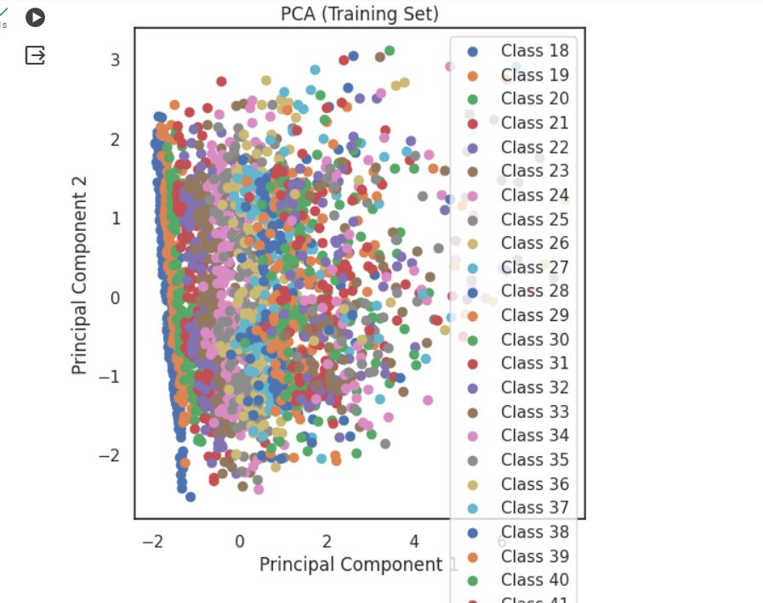
PCA

Slide 17
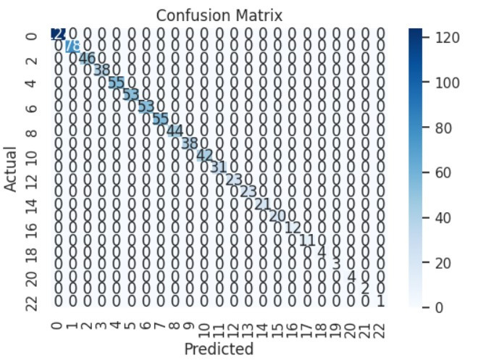
Confusion Matrix

Slide 18
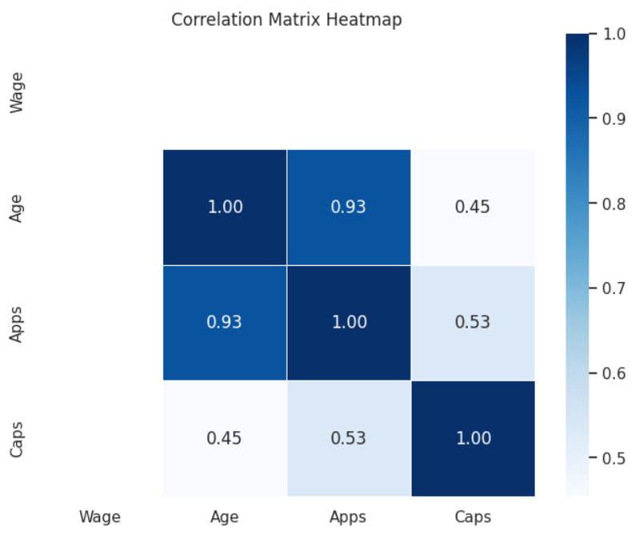
Correlation Matrix

Slide 19
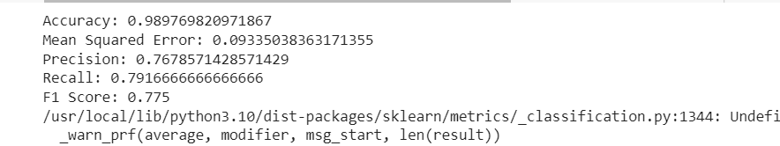

Slide 20
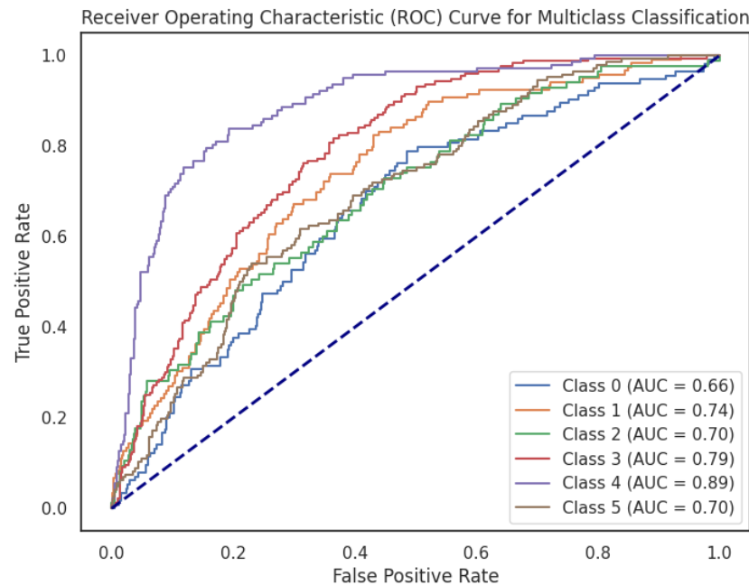
ROC Matrix

Slide 21
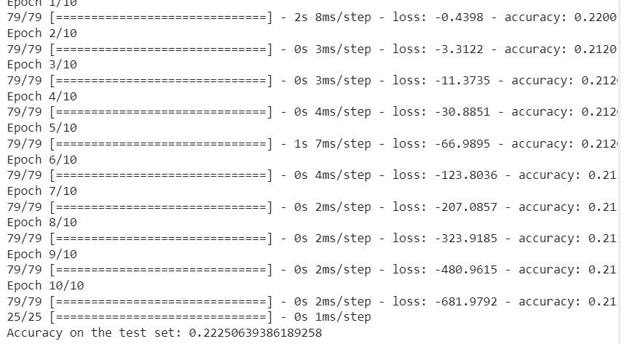
NN

